Slide 1
TEAM MEMBERS: SUMEET ANGADI SUMUKH SANKARSHANA SHREYAS SHET NAHUSH
DATA WAREHOUSE AND DATA MINING

Slide 2


SVM
Support Vector Machine or SVM is one of the most popular Supervised Learning algorithms, which is used for Classification as well as Regression problems. However, primarily, it is used for Classification problems in Machine Learning.
The goal of the SVM algorithm is to create the best line or decision boundary that can segregate n-dimensional space into classes so that we can easily put the new data point in the correct category in the future. This best decision boundary is called a hyperplane.
SVM chooses the extreme points/vectors that help in creating the hyperplane. These extreme cases are called as support vectors, and hence algorithm is termed as Support Vector Machine. Consider the below diagram in which there are two different categories that are classified using a decision boundary or hyperplane:

Slide 3
SVM KERNELS
SVM algorithms use a set of mathematical functions that are defined as the kernel. The function of kernel is to take data as input and transform it into the required form. Different SVM algorithms use different types of kernel functions. These functions can be different types.
Linear,
Polynomial,
Radial basis function (RBF)

Slide 4
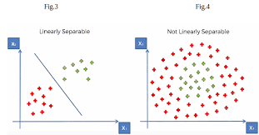

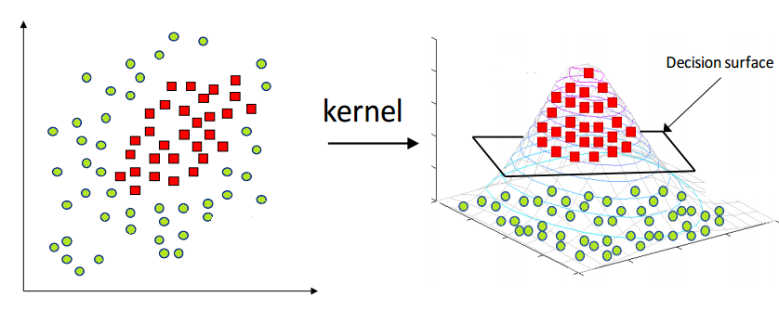

LINEAR KERNEL
This kernel function is used to classify linearly separable data.
POLYNOMIAL KERNEL
In machine learning, the polynomial kernel is a kernel function commonly used with support vector machines (SVMs) and other kernelized models, that represents the similarity of vectors (training samples) in a feature space over polynomials of the original variables, allowing learning of non-linear models.

Slide 5
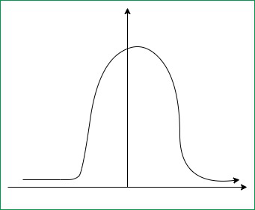
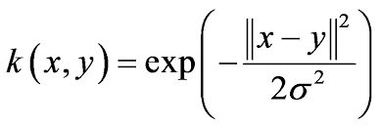
RBF
The RBF kernel function for two points X₁ and X₂ computes the similarity or how close they are to each other. This kernel can be mathematically represented as follows…

Slide 6
PROBLEM STATEMENT
Use a SVM to classify emails into spam or non-spam categories. And report the classification accuracy for various SVM parameters and kernel functions

Slide 7
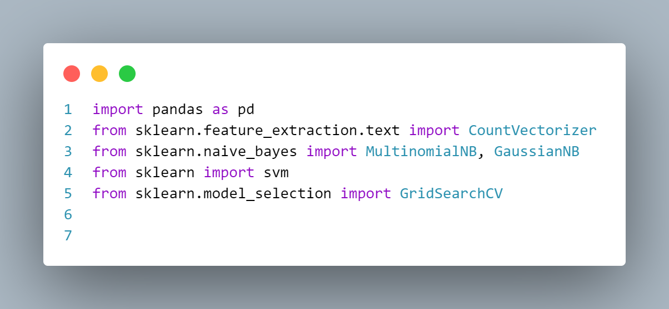
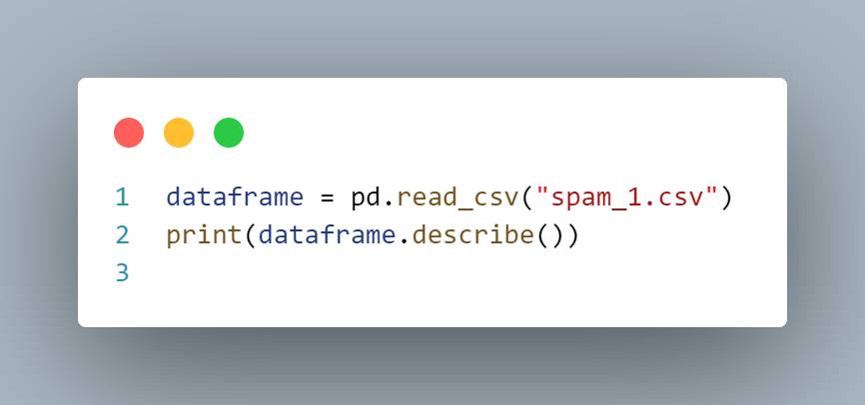
WORKING
STEP 1: IMPORTING LIBRARIES
STEP 2: LOADING THE DATASET

Slide 8
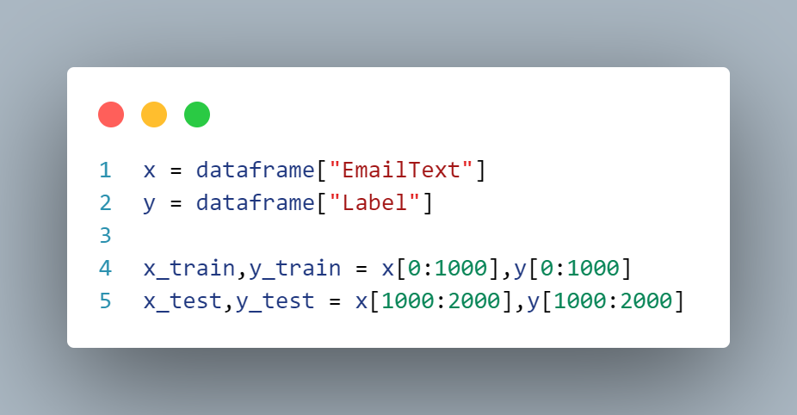
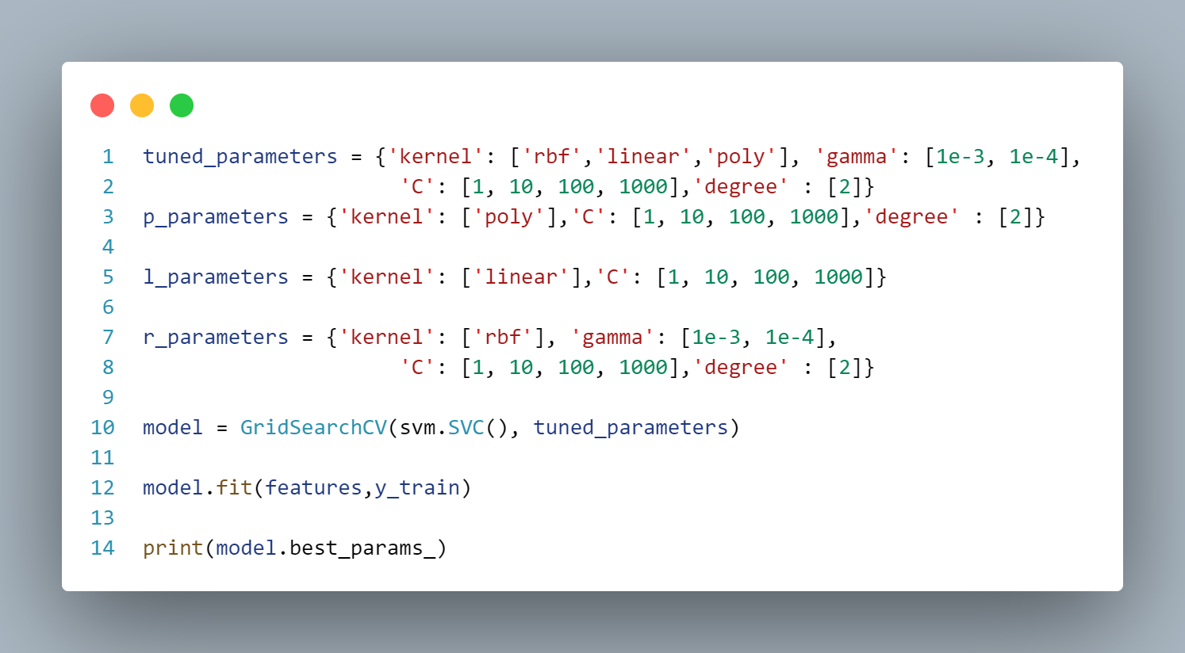
SPLITTING THE DATA INTO TEST AND TRAINING SET
FINDING PARAMETERS

Slide 9
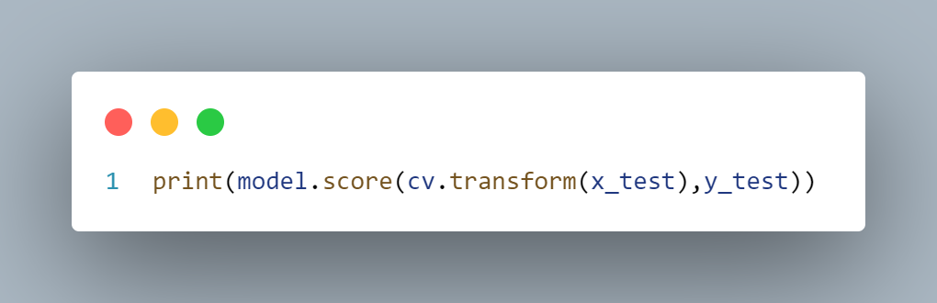
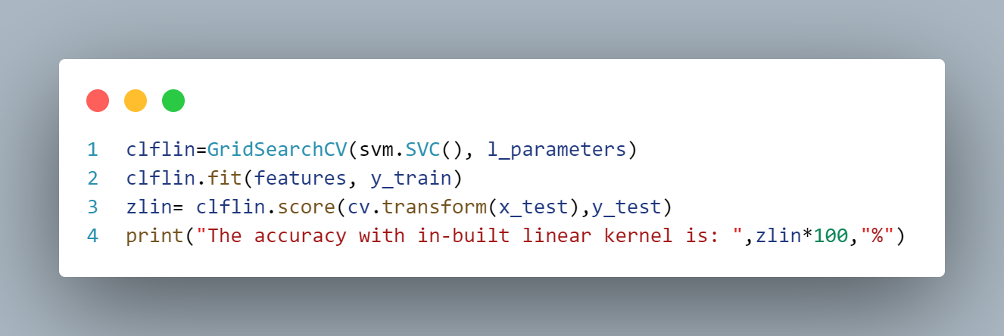
TESTING ACCURACY
LINEAR KERNEL

Slide 10
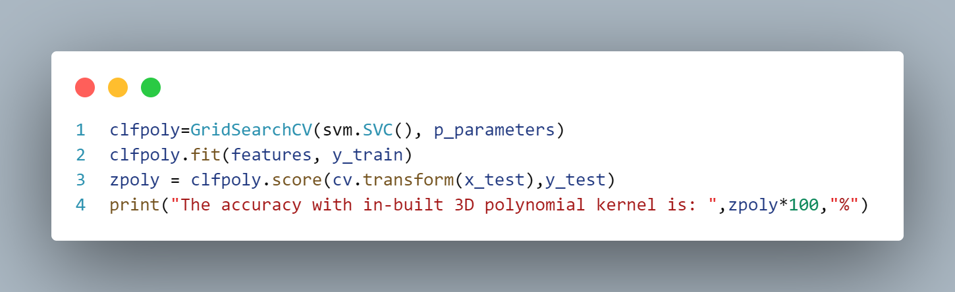
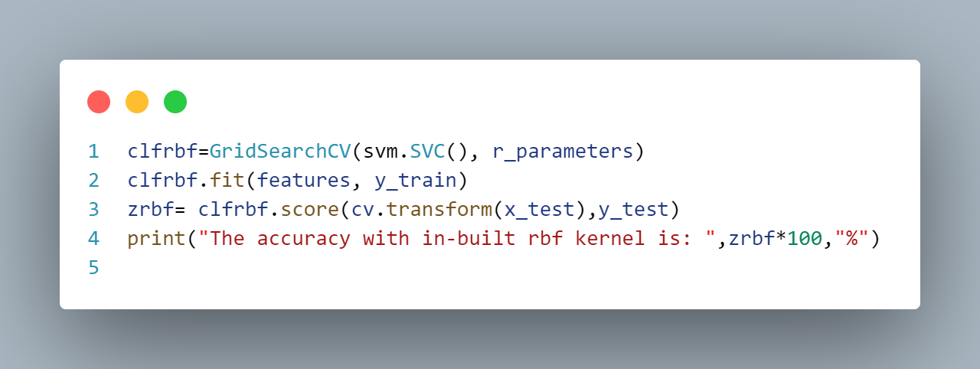
POLYNOMIAL KERNEL
RBF KERNEL

Slide 11
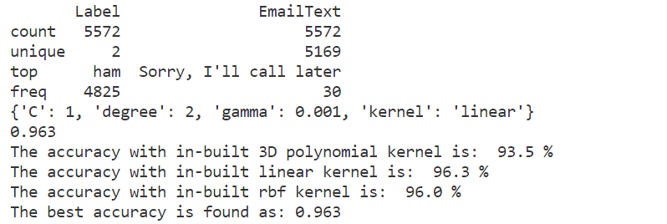
FINAL OUTPUT

Slide 12
THANK YOU

